Slide 1

my A/B test on globox: conclusions and recommendations
Name : rwad amasha
School name : masterschool
Directed to :
Leila Al-Farsi, Product Manager.
Alejandro Gonzalez, User Experience Designer.
Mei Kim, Head of Marketing.

Slide 2

The test:
As you already probably know the A/B test that we conducted in the GLOBOX company divided our users to two groups :
Group A (control group) : the control group is the group that sees the GLOBOX website as it is normally (Contains 24343 users).
Group B (treatment group) : the treatment group is the group that sees the website with the added food banner that highlights the food service that GLOBOX provides (Contains 24600 users).
Our goal is to determine if it is worth it to apply the above change in the GLOBOX website .

Slide 3
Test results from the revenue point of view:
The average amount spent per user in each group in our sample group : Control: $3.375, Treatment: $3.391.
From this data we can be 95% confident that the true amount spent will be :
Control : between 3.049$ and 3.700$ .
Treatment: between 3.073$ and 3.708$ .

Slide 4
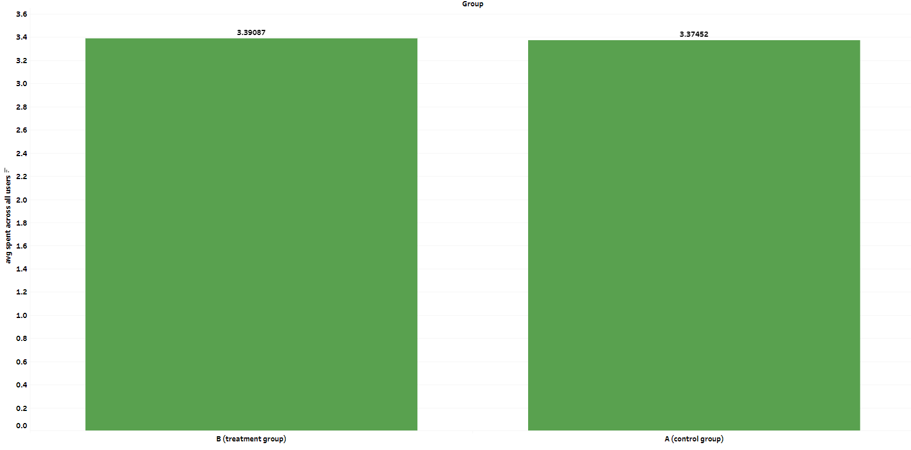

Slide 5
Test results from the conversion point of view:
The conversion rate in each group in our sample group : Control: 3.92% , Treatment: 4.63%.
From this data we can be 95% confident that the true conversion rate will be :
Control : between 3.68% and 4.17%.
Treatment: between 4.37% and 4.89%.

Slide 6
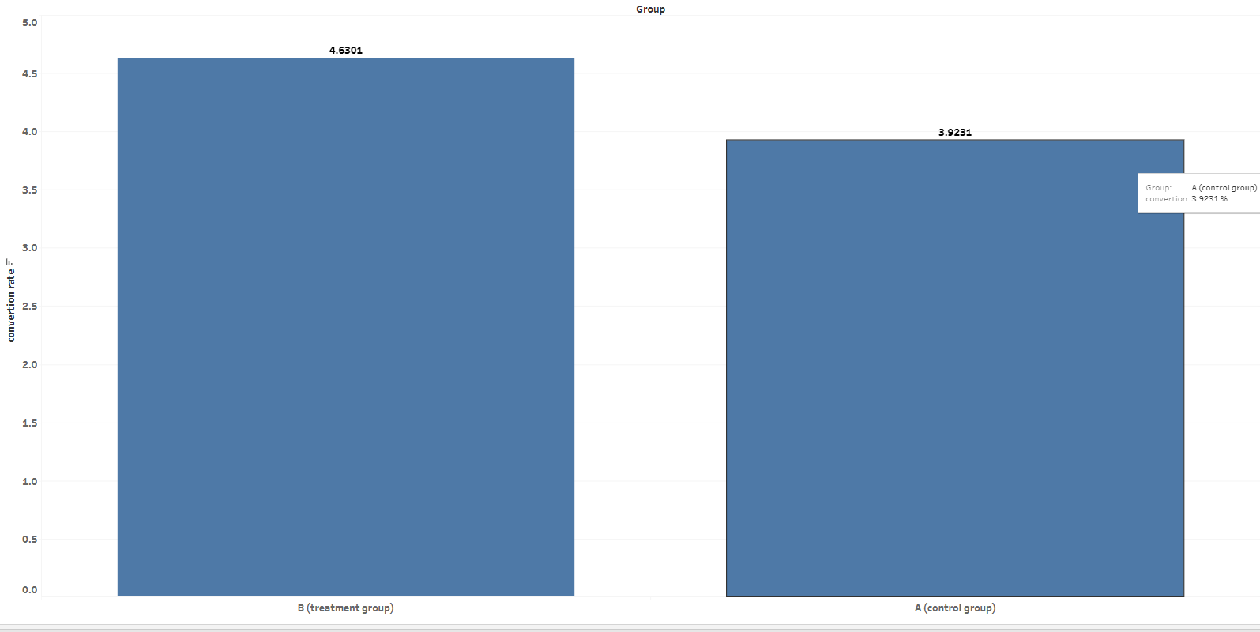

Slide 7

Conclusion
From the results that we saw earlier we can see that in terms of revenue gain the treatment group is a little higher than the control group but the difference is insignificant.
While on the other hand in terms of conversion the treatment group is significantly higher with approximately 1% more users purchasing in the GLOBOX website .

Slide 8
Recommendations :
What should we do ?
We should launch the change .
Why should we launch ?
First of all we could see that the treatment group performed better in both aspects of revenue and conversion although the revenue difference was insignificant . So if we put the revenue aspect aside we can focus on the conversion .
A difference of 1% in conversion rate is a lot and the and change in the website is affordable if we look at what we are getting in return .

Slide 9
Links and sources
Tableau : https://public.tableau.com/app/profile/rwad7818/viz/ABtest_16838101886460/Story1

